Slide 1
Chapter 06:
Implementation with Agile Tools

Slide 2
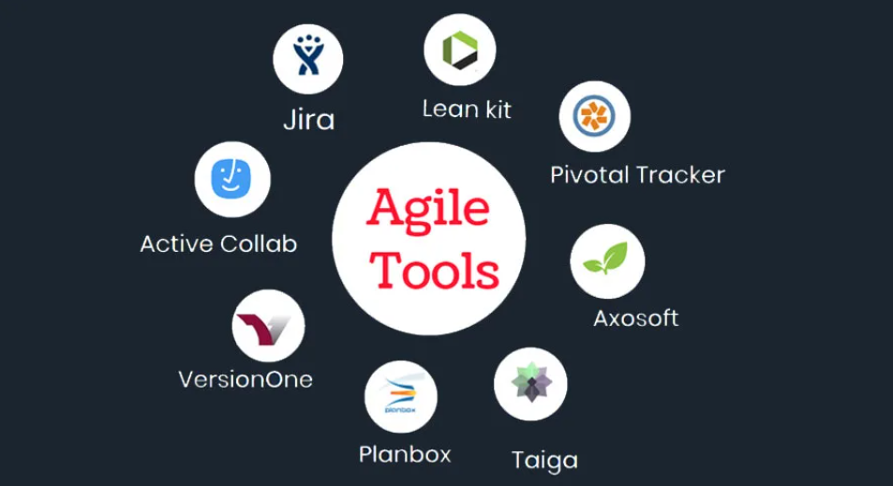
6.1 Introduction to Agile Tools :

Slide 3
6.1 Introduction to Agile Tools :
Agile tools are Project Management Tools designed to support agile methodology: Scrum, Kanban, Scrumban, or other agile hybrid methods.
The following features of agile tools may help the project manager and team members to consider the right one for their business purpose.
Team Collaboration and Communication – The agile tool facilitates collaboration and communication among team members.
Data Storage – An agile tool stores content in a single database, enabling cross-project reporting and analysis.
Reporting and Analytics – The agile tools help analyze the performance and, based on their project manager, can make a report for future business success.

Slide 4
6.1 Introduction to Agile Tools :
What is a Kanban Board?
A kanban board is an agile project management tool designed to help visualize work, limit work-in-progress, and maximize efficiency (or flow). It can help both agile and DevOps teams establish order in their daily work. Kanban boards use cards, columns, and continuous improvement to help technology and service teams commit to the right amount of work, and get it done.
"Kanban" is the Japanese word for "visual signal."

Slide 5
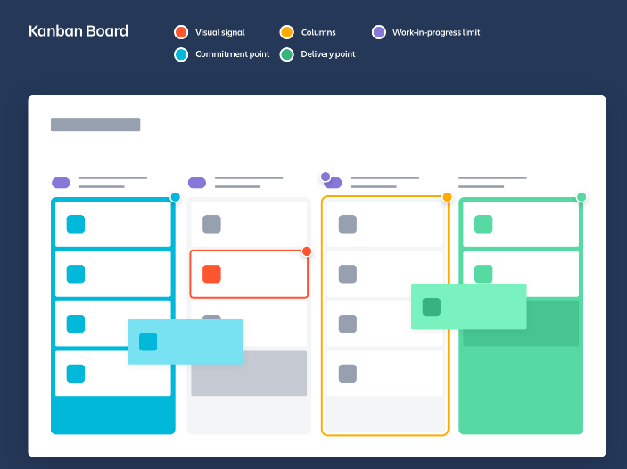
6.1 Introduction to Agile Tools :
Elements of Kanban Board?
Kanban boards can be broken down into five components: Visual signals, columns, work-in-progress limits, a commitment point, and a delivery point.

Slide 6
6.1 Introduction to Agile Tools :
Elements of Kanban Board?
Visual Signals — One of the first things you’ll notice about a kanban board are the visual cards (stickies, tickets, or otherwise). Kanban teams write all of their projects and work items onto cards, usually one per card. For agile teams, each card could encapsulate one user story. Once on the board, these visual signals help teammates and stakeholders quickly understand what the team is working on.
Columns — Another hallmark of the kanban board are the columns. Each column represents a specific activity that together compose a “workflow”. Cards flow through the workflow until completion. Workflows can be as simple as “To Do,” “In Progress,” “Complete,” or much more complex.
Work In Progress (WIP) Limits — WIP limits are the maximum number of cards that can be in one column at any given time. A column with a WIP limit of three cannot have more than three cards in it. When the column is “maxed-out” the team needs to swarm on those cards and move them forward before new cards can move into that stage of the workflow. These WIP limits are critical for exposing bottlenecks in the workflow and maximizing flow. WIP limits give you an early warning sign that you committed to too much work.
Commitment point — Kanban teams often have a backlog for their board. This is where customers and teammates put ideas for projects that the team can pick up when they are ready. The commitment point is the moment when an idea is picked up by the team and work starts on the project.

Slide 7
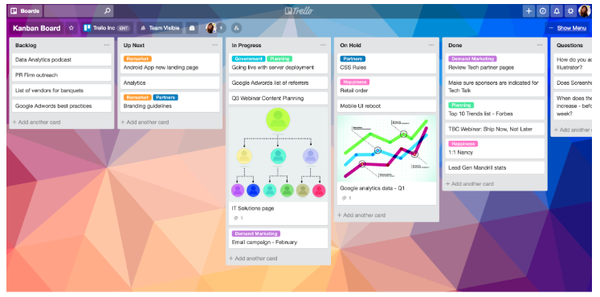
6.1 Introduction to Agile Tools :
Elements of Kanban Board?
5. Delivery point — The delivery point is the end of a kanban team’s workflow. For most teams, the delivery point is when the product or service is in the hands of the customer. The team’s goal is to take cards from the commitment point to the delivery point as fast as possible. The elapsed time between the two is the called Lead Time. Kanban teams are continuously improving to decrease their lead time as much as possible.

Slide 8
6.2 Hands on GitHub :
6.2.1 Create Project using Kanban
Refer below link to see tutorial on how to create project using Kanban
https://www.youtube.com/watch?v=7MDWfAsrrtw
https://www.youtube.com/watch?v=suJBmpECJAY

Slide 9
6.2 Hands on GitHub :
6.2.1 Create Project using Kanban
Creating a Product Backlog of User Stories for Agile Development using GitHub
https://www.youtube.com/watch?v=m8ZxTHSKSKE

Slide 10
6.2 Hands on GitHub :
Hands on GitHub
https://www.youtube.com/watch?v=Ez8F0nW6S-w

Slide 11
What is Git?
By far, the most widely used modern version control system in the world today is Git. Git is a mature, actively maintained open source project originally developed in 2005 by Linus Torvalds, the famous creator of the Linux operating system kernel.
A staggering number of software projects rely on Git for version control, including commercial projects as well as open source. Developers who have worked with Git are well represented in the pool of available software development talent and it works well on a wide range of operating systems and IDEs (Integrated Development Environments).
For example, say a developer, Alice, makes changes to source code, adding a feature for the upcoming 2.0 release, then commits those changes with descriptive messages. She then works on a second feature and commits those changes too. Naturally these are stored as separate pieces of work in the version history. Alice then switches to the version 1.3 branch of the same software to fix a bug that affects only that older version. The purpose of this is to enable Alice's team to ship a bug fix release, version 1.3.1, before version 2.0 is ready. Alice can then return to the 2.0 branch to continue working on new features for 2.0 and all of this can occur without any network access and is therefore fast and reliable. She could even do it on an airplane. When she is ready to send all of the individually committed changes to the remote repository, Alice can "push" them in one command.

Slide 12
Security in Git
Git has been designed with the integrity of managed source code as a top priority. The content of the files as well as the true relationships between files and directories, versions, tags and commits, all of these objects in the Git repository are secured with a cryptographically secure hashing algorithm called SHA1. This protects the code and the change history against both accidental and malicious change and ensures that the history is fully traceable.
With Git, you can be sure you have an authentic content history of your source code.

